Slide 1

2026
Loyola University Chicago
Faculty Benefits
Orientation
Notes:
Welcome to Loyola and this Benefits Presentation! We're happy to offer you and your family comprehensive quality benefit options designed to help you grow personally, financially and professionally. This presentation, along with our plan booklets, is intended to help you consider your needs for the remainder of the calendar year.

Slide 2





Agenda
Contact Information
    Access to online Resources
    Benefit Vendor Information
    Benefit Eligibility
    Life Event Changes
    Health Information
    Key Terms
    Aetna Medical Insurance & CVS Pharmacy Benefit
    Premium Rates
    Find a Provider
    FLIMP-Helps You Make a Choice
    Dental and Vision Insurance
    Dental
    Vision
Tax Advantage Accounts
    Health Savings Account (HSA)
    Flexible Spending Accounts (FSA)
    Ancillary Benefits
    Retirement Plan
    Behavioral Health Resources
    Life Insurance Options
    Tuition Benefits Program
    Leave of Absence
    Section 6
    Questions & Answers
Human Resources

Slide 3
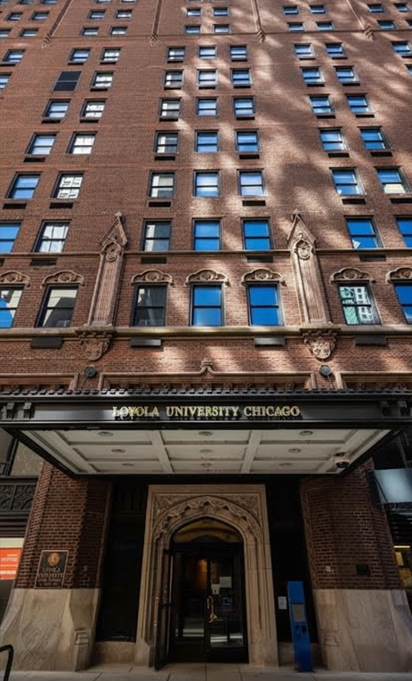

Contact the Human Resources Team
Please reach us using the following options:
Water Tower Campus
Human Resources
Lewis Towers, Suite 820
Email: benefits@LUC.edu
Phone: 312.915.6175
Website: www.luc.edu/hr
LOYOLA UNIVERSITY CHICAGO
Notes:
1.7.2013
We have a list of robust resources for you to make the most
out of your benefits! Please contact the Benefits Team with any
questions.
68
‹#›

Slide 4

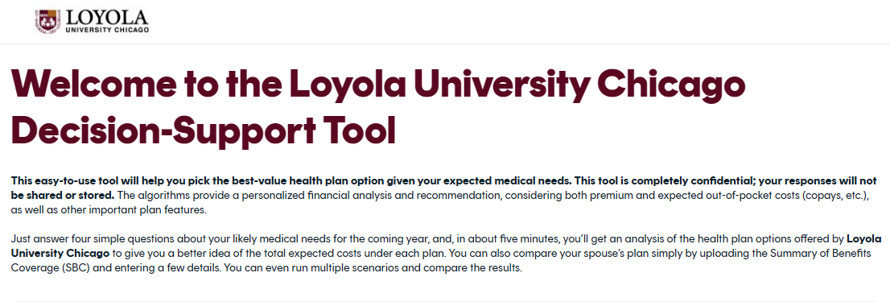
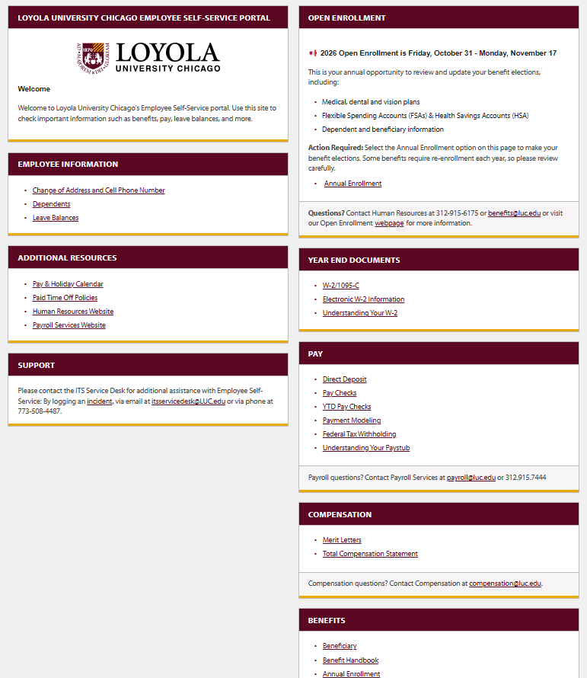
Important Resources
Access to Benefit Booklets & Insurance Plan Guides via HR Home Page: www.luc.edu/hr
FLIMP-Insurance Decision Tool
Employee Self-Service
LOYOLA UNIVERSITY CHICAGO
Human Resources

Slide 5
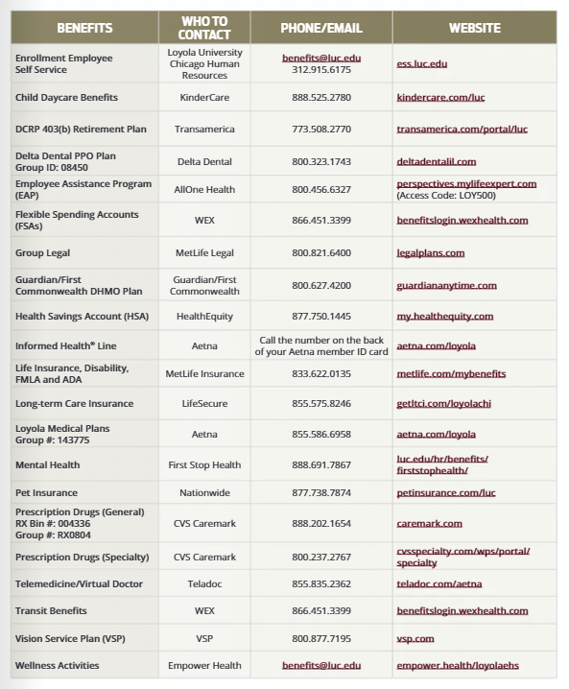
Insurance Vendor Resources
Human Resources
Notes:
1.7.2013
Benefits webpage, guide and benefits bookshelf to view the documents to help support you on your research of our benefit offerings
66
‹#›

Slide 6

Benefit Eligibility
Dependent Eligibility
    Full-time University faculty must be a minimum of .80 FTE.
    Spouse or legally domiciled adult (LDA)
    Children under age 26
    Disabled adult children if covered prior to age 26-Documentation is required
    Adopted children, and children in your custody under a court order of guardianship
    You will need to supply full legal names, dates of birth and Social Security Numbers for all covered dependents.
    Copies of birth certificates and marriage license are required to verify all dependents that will be covered on plans.
LOYOLA UNIVERSITY CHICAGO
Human Resources
Notes:
For LDA eligibility and application please contact the Benefits Department directly.
31

Slide 7


Benefit Enrollment Highlights
Where and How do I Enroll?
    Use Employee Self-Service (ESS): https://ess.luc.edu
    Enroll within 31 days of your start date..
    Trouble accessing ESS? Contact the ITS Service Desk: ITSServiceDesk@luc.edu or call 773-508-4487.
What do you need to do during New Hire Enrollment & when do my benefits take Effect?
    Go to ESS and elect your benefit options or WAIVE coverage.
    Enroll/elect in FSAs & HSA through ESS.
    Must complete Tobacco Premium and Spousal Premium Certifications in ESS.
    Add your dependents, beneficiaries. And upload birth and marriage certificates.
    Your Benefits, when elected, become active the 1st of the month immediately following your hire date. If you hire date is the 1st your benefit will be effective that same date once enrolled.
    Enrollment with each vendor is not immediate, please give each vendor at least one-two business weeks to process your enrollment and gain access to download your ID cards.
LOYOLA UNIVERSITY CHICAGO
Human Resources

Slide 8
Post New Hire Benefit Enrollment Changes
3 opportunities to enroll and make changes to your Benefits
in the Employee Self-Service Portal
    Initial new hire enrollment: New employees have 31 days from their hire date to enroll
    Open Enrollment : Changes are effective January 1st
    Qualifying Life Event: Notify HR within 31 days of event
Qualifying Life Events
    Change in legal marital status
    Change in number of eligible dependents, Employment status change for you, your spouse/LDA, or your dependent
    Taking an unpaid leave of absence
    Dependent satisfies or ceases to satisfy eligibility requirement (attainment of age limit, marriage)
    Residence change by you, your spouse/LDA, or dependent (moving outside of the country)
    Change in cost or coverage due to spouse/LDA or dependent’s open enrollment
LOYOLA UNIVERSITY CHICAGO
Human Resources
Notes:
1.7.2013
32
‹#›

Slide 9
Aetna Medical, Prescription Drug Dental and Vision
Human Resources

Slide 10

Medical Insurance –Aetna & CVS Caremark
Review your Medical Plan Options | PPO | HDHP
 | In-Network | In-Network
Deductible Individuals Family | Embedded $750 $1,500 | Aggregate $1,800 $3,600
Out-of-Pocket Maximum Individual Family | $3,500 $7,000 | $4,600 $9,200
Coinsurance – Member Share | 10% Home Hospital 20% In Network | 10% Home Hospital 20% In Network
Office Visit / Outpatient | Deductible & Coinsurance | Deductible & Coinsurance
Inpatient Services (Medical and Behavioral Health) Home Hospital In-network Hospital | $100 copay, then Coinsurance $250 copay then Ded. & Coins. | Deductible & Coinsurance
Prescription Drug Deductible Individuals/Family (You + 1 or more) Does not apply to mail order | $100 / $200 | Included in Medical
Prescription Drug Out-of-Pocket Max Individuals / Family (You + 1 or more) | $3,000 / $6,000 | Included in Medical
Prescription Drug Benefit Retail Generic / Preferred / Non-Preferred Mail Order Generic / Preferred / Non-Preferred | 15% / 30% / 45% 5% / 15% / 25% | Deductible & Coinsurance
LOYOLA UNIVERSITY CHICAGO
Notes:
Loyola offers 2 medical plans. PPO has a $750 deductible per individual and a maximum of $1,500 deductible for you and covered dependents. After the deductible is met, coinsurance is 90% in home hospitals, 80% for all other Aetna providers. Your total out of pocket maximum in network is $3500 for one and $7000 for an employee plus one or more dependents. The deductible would be $1200 for one and $2400 for more than one covered person in your family. The coinsurance is the same, and your maximum out of pocket is $4,000 for one person and $8000 for more than one person covered. Preventive services remain covered at 100% in network and provided at no cost to you on both plans. These benefits shown are for covered services OTHER THAN outpatient prescription drugs.
Two Medical Plan Options: PPO , HDHP
Have the same quality and level of coverage
Are administered by Aetna
Offer the flexibility and access to large network
of providers part of the PPO network
Coinsurance is 90% when you use home hospitals
Most routine preventive care from in-network doctors is covered 100% at no cost to you. For most other services, you pay health care costs until you meet the annual deductible
Are subject to different annual out of pocket cost, deductible and monthly premiums
Tobacco smokers are subject to additional cost
Faculty members adding spousal coverage will pay a premium if their spouses do not qualify for a waiver
PPO Family Deductible is Embedded – No single individual on a plan with employee and a spouse/LDA and/or child(ren) will have to pay a deductible higher than the individual deductible amount
HDHP Family Deductible is Aggregate - The entire family deductible must be met before the insurance company starts paying for healthcare costs for anyone in the family.
Out of Pocket Maximum – Includes Deductible, Coinsurance and Prescription Drug Expenses
PPO & PPO 2 have a separate medical and RX out of pocket maximum, the total of both in either plan option is greater than that of HDHP HSA’s combined out of pocket maximum
Health Savings Account (HSA) Compatible – Includes an HSA to use for eligible medical expenses
Loyola contributes $600 (You) or $1,200 (You + 1 or More)
You can contribute on a pre-tax basis, too!
Limited FSA – You can contribute up to $3,200 pre-tax to use for eligible 2025 dental and vision expenses
Preventive Drug List– Some preventive prescriptions require you to only pay coinsurance, even without meeting the deductible yet
Lower Premiums –HDHP HSA monthly premiums are considerably lower than the existing plan options
Like the PPO, you can still take advantage of:
Preventive Exams and Certain Preventive Prescriptions covered at 100%
National PPO Network – Utilizes the large national Aetna PPO Network; Coinsurance is 90% when you use Home Hospitals
37
‹#›

Slide 11


Loyola Prescription Drug Plan
    Medical plan participants only
    No separate enrollment needed for prescription coverage
    PPO have a separate medical and RX deductible and out of pocket maximum
    HDHP HSA has a combined deductible and out of pocket maximum
    Complete list of participating pharmacies at www.caremark.com
    Welcome Kits sent to your home address will include ID card(s)
    You can use other Pharmacy Retail outlets besides CVS such as: Walgreens, Target, and Walmart. Just present your CVS Card.
    Prescription for contraceptives are excluded on the Loyola medical plan. However, there is a program available where by you can obtain certain contraceptive prescriptions at no cost to you, as part of the Affordable Care Act. In order to obtain these you will obtain a separate ID card directly from CVS.
LOYOLA UNIVERSITY CHICAGO
Notes:
Everyone who enrolls in PPO or HDHP will receive a new ID card from CVS at their home address. These are expected to arrive a few weeks after you enroll and submit your elections. One card will be sent for single coverage and two cards for those of you with dependent coverage. If for some reason you do not receive a card, the RX BIN and Group # would allow you to obtain a prescription at the pharmacy. You can use one of the thousands of pharmacies that are part of the CVS Caremark network including Walgreens, CVS, Jewel/Osco, Walmart, Costco, and many more. Keep in mind that some prescriptions require prior authorization in order to be covered under the plan, and some prescriptions are excluded under the plan.

Slide 12





FLIMP Decision Tool
Need assistance determining which plans are best for you and your family?
  PPO vs HDHP
  Vision Insurance
  Dental PPO vs DHMO
Flimp Decisions is here to help!
Selecting the best Medical plan is simple. Based on your responses to just a few questions, Flimp will match you with the best-fit medical plan.
Visit FLIMP:
The Flimp Decision tool takes less than 5 minutes on average
LOYOLA UNIVERSITY CHICAGO
Notes:
Aetna, All One Health and First Stop Health all provide mental health resources. Please visit our mental health resource page
Your Aetna medical plan provides coverage to you and covered family members for both inpatient and outpatient mental health services and substance use treatment. You can locate behavioral health professionals who specialize in mental illness, addiction and other conditions such as anxiety, depression, stress, etc., by contacting the Aetna Concierge Line (Monday to Friday, 8:00AM - 6:00PM CST): 855.586.6958 or access the Aetna online portal
AllOne Health. and is available to all employees and their families at no cost. Assessment, referral, and short-term counseling services are provided at no cost. If a referral includes ongoing counseling for mental health or s
substance use, Perspectives will help coordinate the referral with insurance, as appropriate.
First Stop Health (FSH) is a virtual mental health resource that provides support for mental well-being anytime, anywhere. This resource offers Loyola benefits-eligible faculty and staff and their family members 24/7 access to short-term, solution-focused counseling via app, web or phone. Plus, there is zero cost for faculty/staff and their family members to access this care.
47

Slide 13

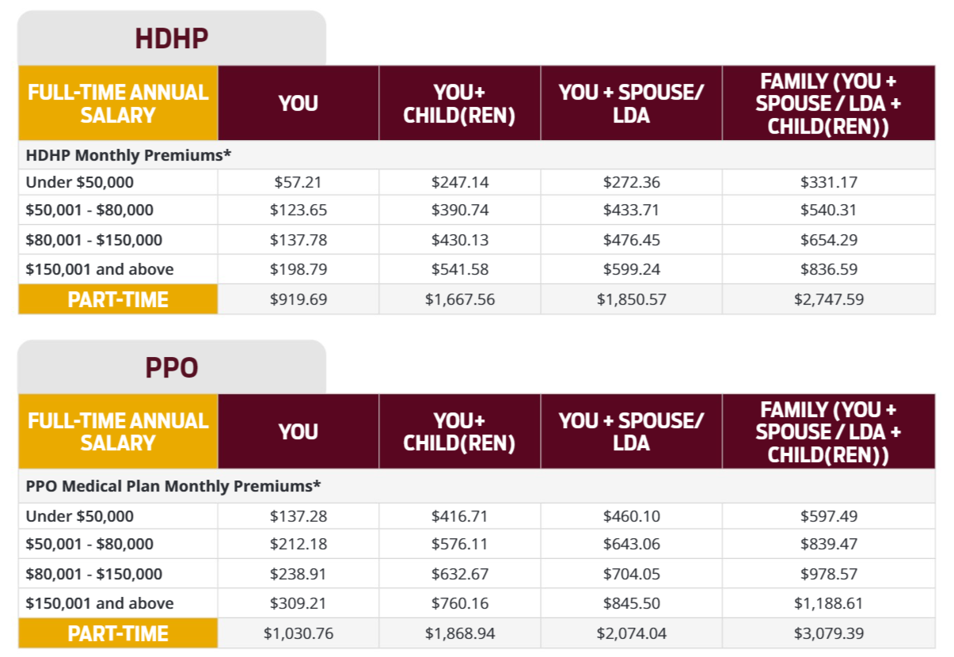

Medical Insurance - Rates
LOYOLA UNIVERSITY CHICAGO
Access to additional insurance rates are available via the HR homepage.

Slide 14


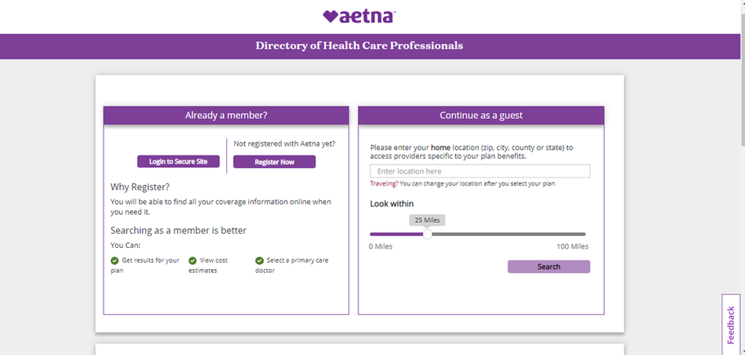

How to Find a Network PPO Medical Provider
Aetna Choice® POS II (Open Access)
www.aetna.com/loyola
Select Maximum Saving Provider for Higher Discounts
Same Network for All Plans
Aetna Choice® POS II (Open Access)
LOYOLA UNIVERSITY CHICAGO
Notes:
1.7.2013
40
‹#›

Slide 15

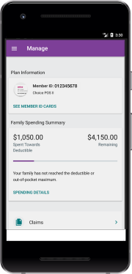

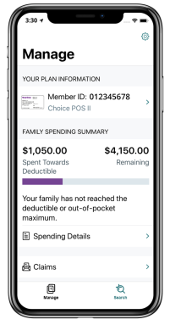

Aetna Health App
Manage benefits, view and pay claims
View progress toward your deductible
Find a doctor or urgent care center
Get cost estimates before you get care
Schedule doctor appointments
LOYOLA UNIVERSITY CHICAGO
Notes:
1.7.2013
43
‹#›

Slide 16











Aetna Member Resources
Use the Aetna website and/or mobile app to make
the most of your benefits
Find Care
Cost of Care
Quality & Cost
Find and
compare doctors
Download digital ID cards
Minute Clinic, Urgent Care or ER
Read doctor reviews
Get estimates for your
out-of-pocket costs
Track account balances and progress toward your deductible
Manage and pay claims
Get coverage and
benefits information
Use information to help make treatment decisions
Look up
symptoms, conditions
and medications
LOYOLA UNIVERSITY CHICAGO

Slide 17
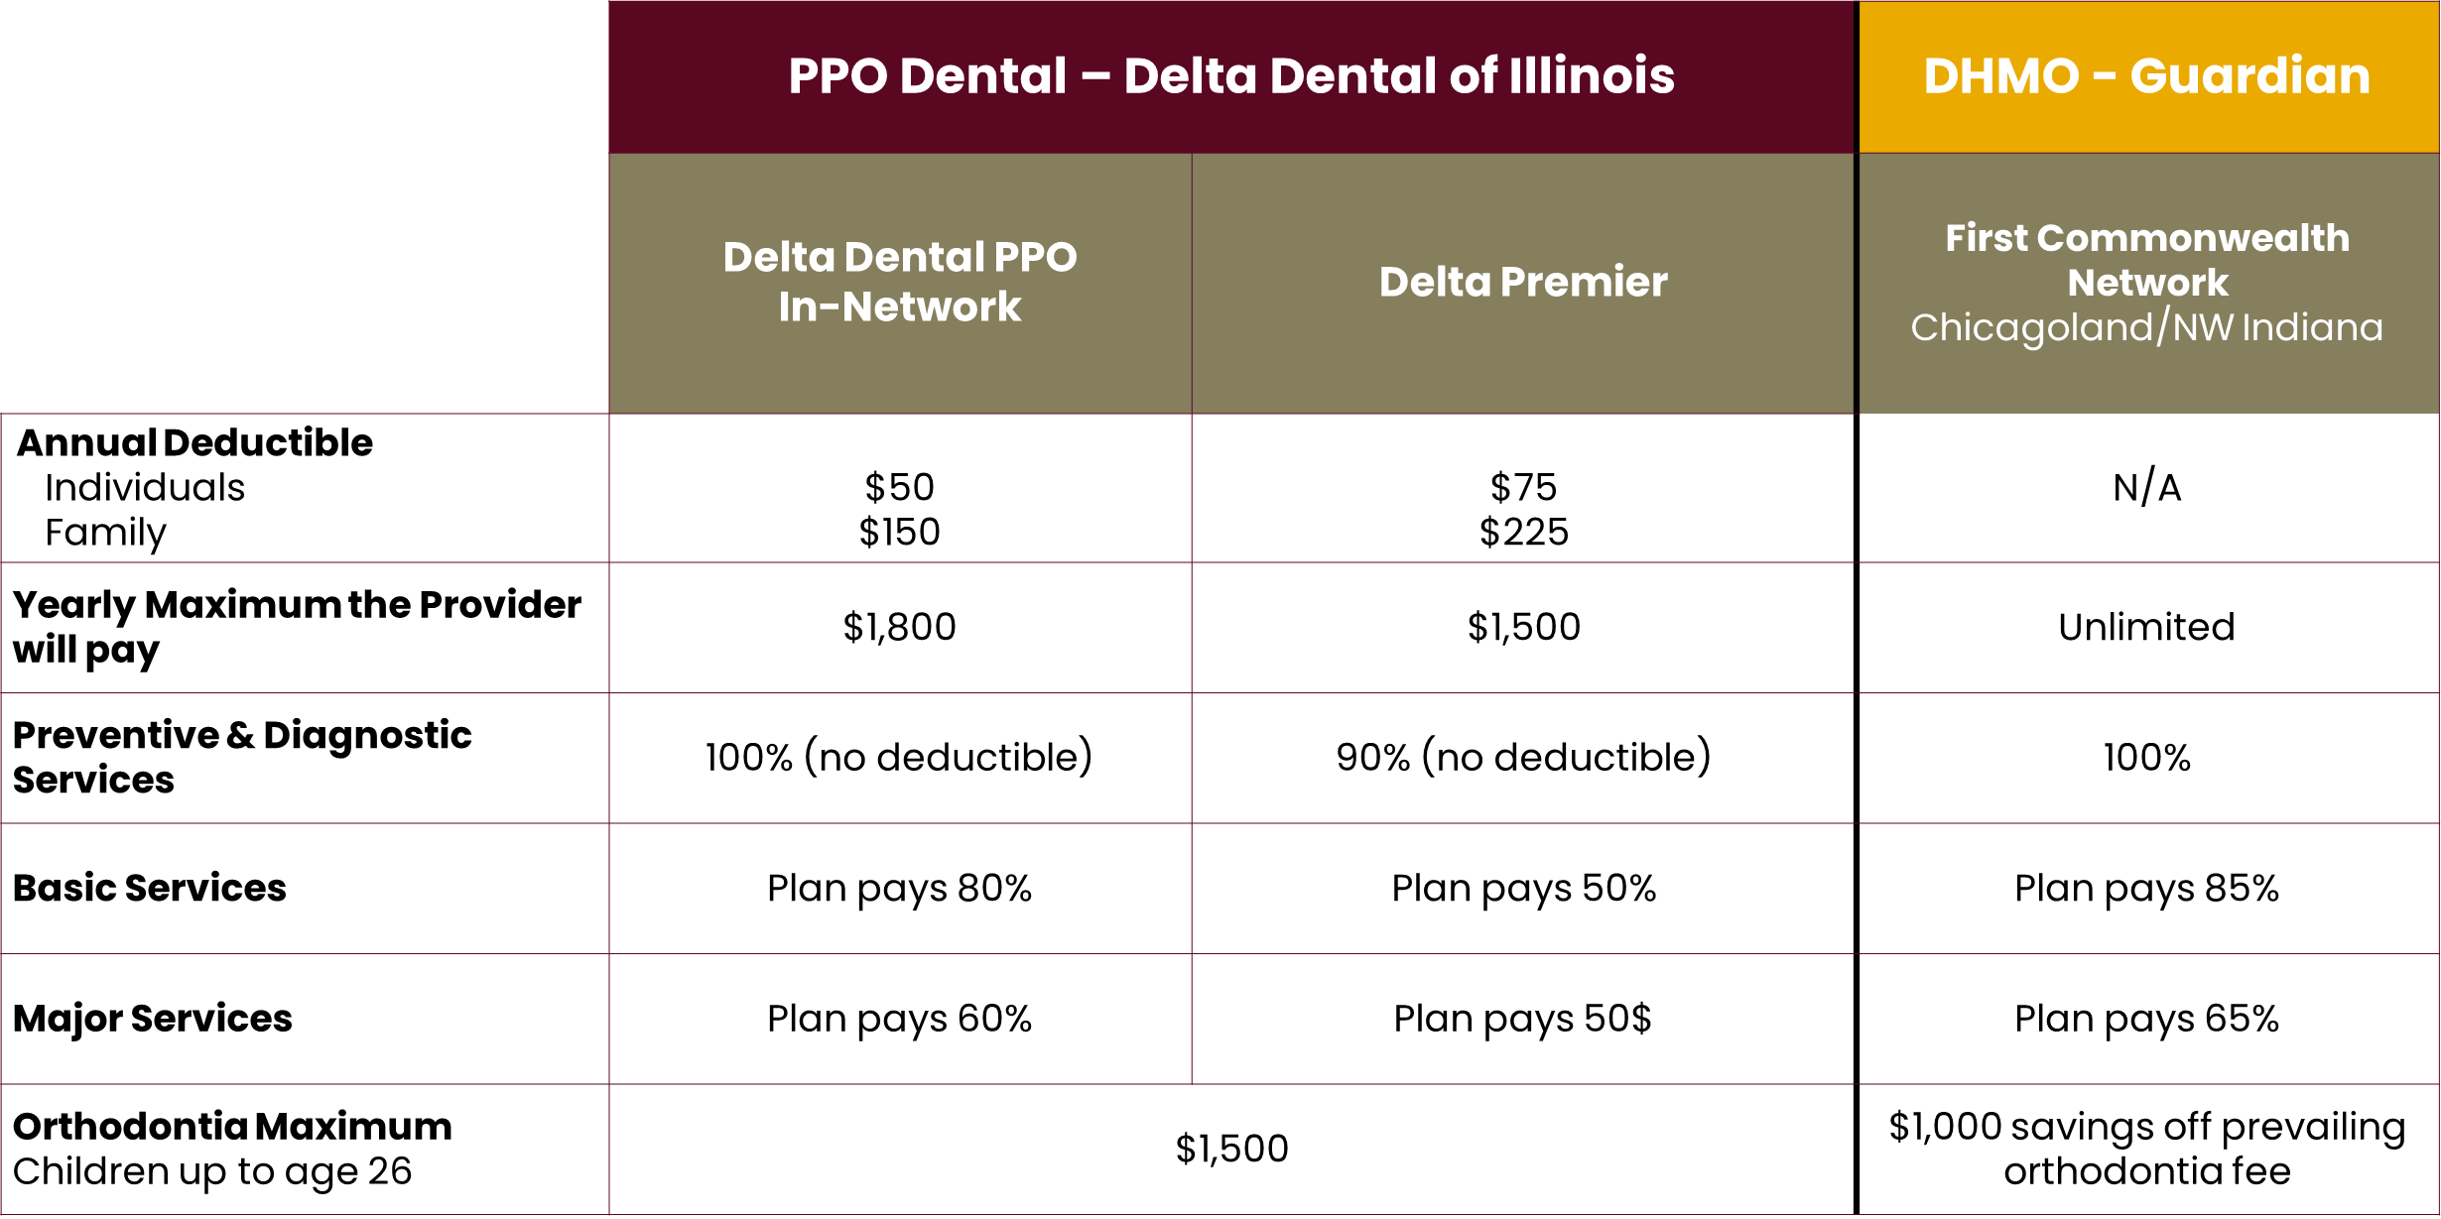


Dental
LOYOLA UNIVERSITY CHICAGO
Notes:
Loyola University Chicago's benefit-eligible faculty and staff have their choice of two Dental plans: Delta Dental PPO and Guardian/First Commonwealth (DHMO):
Delta Dental PPO provides two levels of coverage as well as an option for out of network services.
Delta Dental PPO participants are subject to annual deductible and benefit limitations based on the service level of the primary care dentist.
Guardian/First Commonwealth (DHMO) only operates in the Northern Illinois/Chicagoland & Northwest Indiana area and participants must choose a primary care dentist first, submit this information to Guardian and have an ID card with the dentist name in hand before services are rendered.
There is no annual deductible, and services rendered are not subject to maximum benefit limitations.
If you decide to change your dentist you must first call Guardian/First Commonwealth at 866-494-4542. The change process takes approximately 20 days.
An up-to-date list of the names and locations of participating dental providers may be found online: www.guardiananytime.com.

Slide 18

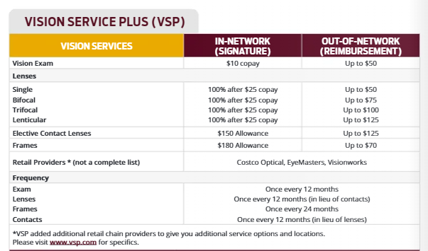

Vision
Vision Service Plan (VSP) provides comprehensive eye care benefits throughout the VSP network for routine services. Members also have access to discounts available at www.vsp.com.
Aetna Vision Discounts:
Employees and family members enrolled in our Aetna medical plan are eligible for vision savings under Aetna's EyeMed vision discount program. Please keep in mind this is not insurance but a discount savings program. Visit www.aetna.com for more information and to find a location.
LOYOLA UNIVERSITY CHICAGO

Slide 19
Tax Advantage Accounts
Health Savings Accounts (HSA)
Flexible Spending Accounts (FSA)

Slide 20


Health Savings Account (HSA)- Health Equity
    *For HDHP members only. A Health Savings Account (HSA) is a bank account that allows you to save and pay for your share of everyday qualified health care expenses tax-free.
    Loyola will contribute to your HSA account with the first paycheck after you enroll. Enroll in your HSA payroll contribution at https://ess.luc.edu.
    Amounts below are prorated based on hire date.
$600
Employee Only
$1200
Employee + 1 or more
You can contribute up to the following amounts tax free in 2026:
Individual = $4,400 total or $600 Loyola + up to $3,800
Family (You +1 or more) = $8,750 total or $1,200 Loyola + up to $7,550
If you are 55 or older, you can contribute an additional $1,000 in catch-up contributions, too.
You can change your contributions throughout the year by emailing benefits@luc.edu.
You must re-elect HSA every year during Open Enrollment
LOYOLA UNIVERSITY CHICAGO

Slide 21



HSA Q&A
How do I qualify for an HSA?
You must be enrolled in an HSA qualified health plan option (HDHP HSA). If addition, you cannot be covered by another health plan (including Medicare or Tricare) or be claimed as a dependent on another person’s tax return.
What expenses qualify for payment from an HSA?
Funds in your HSA can be used to pay for any eligible medical, dental, or vision expenses – doctor’s visits, prescriptions, lab tests, and hospitalizations. See IRS Publication 502 for a complete list of qualified expenses.
Do HSA funds expire?
Your HSA funds never expire. Any funds you don’t spend roll over year after year and can be saved and invested for retirement. There is an annual limit for contributions, but the total balance of your account has no limit.
What happens if I change jobs or health plans?
You own your HSA. If you change jobs or health plans, you continue to own your account. If you enroll in another HSA-qualified health plan, you can continue to contribute to your HSA. If you choose another type of health plan, you are still eligible to spend the funds in your HSA on qualified medical expenses — for you, your spouse, and your tax dependents.
What are the fees for having this account?
The monthly maintenance fee is employer paid by Loyola. $1.90 per employee per month if the monthly average balance is $3,000 or less. No fee if the monthly average balance is $3,000 or higher.
LOYOLA UNIVERSITY CHICAGO

Slide 22






Flexible Spending Account (FSA)- WEX Health
HEALTHCARE
FSA
LIMITED FSA
SELECT YOUR
FSA ACCOUNTS
    HEALTH CARE FLEXIBLE SPENDING ACCOUNT (HFSA)
    LIMITED FLEXIBLE SPENDING ACCOUNT (LFSA)
    DEPENDENT CARE EXPENSE ACCOUNT
    You can elect the above benefits as a new or after a qualifying life event.
    TRANSIT
    You can enroll in transit at anytime and make changes through out the year.
$3,400
Annual Limit
$3,400
Annual Limit
DEPENDENT CARE
$7,500
Annual Limit
TRANSIT
$340 Per Month
Typically, contributions are use-it or lose-it! For the HFSA and the LFSA 2026 participants. If you do not use all of your contributions, you are eligible to carry-over a max of $680 of remaining FSA funds to the 2027 plan year. To carry-over the funds, you need re-enroll in the HFSA or the LFSA in the new year.
Notes:
Even when you have insurance, your copays and other expenses have a way of adding up. The good news is you’re eligible to participate in a Flexible Spending Account, or FSA. An FSA helps you save on your taxes, by allowing you to set aside tax-free money every month to pay for hundreds of eligible out-of-pocket health care expenses.
FSAs are great because the money you contribute is PRE-TAX income! It’s like getting an automatic discount on every eligible expense.
There are two main types of FSAs: a Healthcare FSA and a Dependent Care FSA. To be eligible for the Healthcare FSA, you cannot be enrolled in the HDHP with an HSA.
The use it or lose it rules apply, so consider your contributions carefully.

Slide 23
Ancillary Benefits
Retirement
Life & Disability
Accident
Critical Illness

Slide 24
Retirement Plan – Transamerica 403(B)
University Contributions
5% automatic University contribution after your first anniversary
Up to 5% matching contribution when you contribute
Total possible University contribution: 10%
Employer contributions are traditional pre-tax contributions only (not Roth)
Vesting
Employee contributions: Always 100% vested
University contributions:
50% vested between your 1st and 2nd anniversary
100% vested after your 2nd anniversary
2026 Contribution Limits (IRS)
Employee Limit: $24,500
Catch-Up Limit (age 50-59 or 64+): Additional $8000.00
Catch-Up Limit (age 60-63): Additional $11,250
If you contributed to retirement plans outside of the University, please review and adjust contributions to remain within the IRS limits across all employers for the calendar year.

Slide 25
Retirement Plan – Transamerica 403(B)
Traditional vs. Roth Contributions (Quick Comparison)
Traditional
Contributions are pre-tax
Withdrawals are taxed as income
Roth
Contributions are after-tax. Qualified withdrawals are tax-free*
*Qualified Roth distributions require: At least 5 years since your first Roth contribution and Age 59½ (or disability or death)
Secure Act 2.0 requires mandatory Roth contribution catch-up for those age 50+ and who earned more than 150K FICA wages from the University in prior year.
Employer contributions are traditional pre-tax contributions only (not Roth).
Make your Loyola University Chicago 403(b) retirement plan elections with Transamerica at: https://www.transamerica.com or by calling 800.755.5801
LOYOLA UNIVERSITY CHICAGO

Slide 26
Behavioral Health
Many people deal with some form of behavioral health conditions, both acute or long term. You have access to many resources to support you and your loved one’s mental health.
Aetna network providers
Access providers through the Aetna network
Visits are paid through the medical plan (member deductible and coinsurance apply)
Therapists/psychiatrists available online daily from 7 am to 9 pm
Costs vary; therapists range from $0-$85 per visit, psychiatrist from $0-$180 per visit. Enroll with Teladoc for pricing
AllOne Health – Employee Assistance Program (EAP)
Access to AllOne Health counselors by calling 800-456-6327
Consultations/visits are free for employees and dependents
After 3 initial visits, you are referred to an Aetna network provider
First Stop Health
Access providers at https://www.fshealth.com/ or call 888-691-7867
Free virtual visits for employees and dependents
Short-term, solution-focused counseling via app, web or phone.
Will refer to Aetna network provider if needed
Behavioral therapy
Also known as talk therapy. It’s one of the main ways to treat a behavioral health condition.
Medication therapy and management
Treatment may involve taking prescription medications. There are many that are effective for treating conditions like depression and substance use disorders.
Your care advocate
They’ll work closely with you to support your emotional health and everyday needs. They can do all the legwork to help you give your emotional health the high priority it deserves.
LOYOLA UNIVERSITY CHICAGO
Notes:
Aetna, All One Health and First Stop Health all provide mental health resources. Please visit our mental health resource page
Your Aetna medical plan provides coverage to you and covered family members for both inpatient and outpatient mental health services and substance use treatment. You can locate behavioral health professionals who specialize in mental illness, addiction and other conditions such as anxiety, depression, stress, etc., by contacting the Aetna Concierge Line (Monday to Friday, 8:00AM - 6:00PM CST): 855.586.6958 or access the Aetna online portal
AllOne Health. and is available to all employees and their families at no cost. Assessment, referral, and short-term counseling services are provided at no cost. If a referral includes ongoing counseling for mental health or s
substance use, Perspectives will help coordinate the referral with insurance, as appropriate.
First Stop Health (FSH) is a virtual mental health resource that provides support for mental well-being anytime, anywhere. This resource offers Loyola benefits-eligible faculty and staff and their family members 24/7 access to short-term, solution-focused counseling via app, web or phone. Plus, there is zero cost for faculty/staff and their family members to access this care.
47

Slide 27



Life & Disability
Employee & Dependent Life Insurance
    Basic Life automatically provided at 1.5x salary to a max of $500,000
    Voluntary Supplemental Life Insurance.
      You - Up to 5x salary ($500k max)
      Guarantee Issue $250k when first eligible
    Spouse – Up to 100% of your approved amount
      Maximum of $100,000
      Guarantee Issue $25k when first eligible
    Child(ren) – $5k ($1k < 6 months) Guarantee Issue (no health questions)
    You must elect supplemental life Insurance for yourself before you elect spouse or Child-Always add your Beneficiaries
    Disability Insurance , you don’t have to elect- You are enrolled when you become eligible
    Short-Term Disability – The University automatically provides Short-Term Disability (STD) coverage to all full-time benefit-eligible faculty up to 26 weeks.
    Long Term Disability – The University automatically provides Long-Term Disability to all full-time benefit-eligible faculty.
LOYOLA UNIVERSITY CHICAGO
Notes:
1.7.2013
As an eligible employee, you are covered for 1½ times your annual salary for life and accidental death and dismemberment insurance. This is paid by Loyola. And insured by MetLife. You also have short and long term disability coverage through MetLIFE if you are full-time benefit-eligible. This also is paid for by Loyola. In addition, you can purchase supplemental life insurance for you, up to 5 times your salary. If this is the first time you are eligible for this coverage, then you can elect up to $250,000 without having to answer any health questions. Amounts you request in excess of $250,000 are subject to Statement of health, or, if this is not the first time you were eligible to buy this coverage, then you are also subject to evidence of insurability for any amounts you are requesting. This means you will answer some health questions to determine if Reliance will accept or decline your application for coverage. You can also purchase coverage for your spouse, but you must purchase coverage on yourself to buy insurance on your spouse or children. Evidence of insurability may also be required on your spouse as well. Premiums of age rates and the rate tables are posted online through the Loyola HR website. You can also purchase voluntary accidental death and dismemberment coverage. There are one of four coverage levels you can purchase.
58
‹#›

Slide 28




Critical Illness & Group Accident
Critical Illness (CI)
Pays a Lump sum benefit directly to you upon diagnosis of a covered critical illness.
Group Accident
Pays a Lump sum benefit directly to you upon diagnosis of a covered critical illness.
These benefits include a wellness Health Screening Benefit if you receive a health screening you will receive an amount for both policies.
You choose either a $10,000 or $20,000 lump sum benefit for you or your dependent.
Covers you, your spouse or child if you are diagnosed with an illness such as cancer, heart attack or stroke.
And associated medical expenses
Pays a lump sum benefit when you seek treatment for injuries sustained in an accident where fractures, burns and etc occur.
Possible time or compensation for injuries from accidents
      Out-of-pocket medical expenses
      Durable Medical Equipment
      Lost income
$10,000 CI coverage and basic Group Accident is provided at no cost to employees who enroll in
HDHP .
(coverage for other dependents and those not enrolled in HDHP may be purchased voluntarily).
Additional supplemental life policies are also available.
LOYOLA UNIVERSITY CHICAGO

Slide 29
Leave of Absences
EAP
Tuition Benefit
Other Benefits
Notes:
This slide highlights several important benefits and support programs available to Loyola employees. Let’s start with Leave of Absence options. Loyola offers various types of leave, including Short-Term Disability (STD), Long-Term Disability (LTD), Family and Medical Leave (FMLA), Parental Leave, and ADA accommodations. Each type of leave has specific eligibility requirements and processes, so it’s important to work with Human Resources and MetLife to initiate a claim if needed. For example, STD requires six months of full-time employment and includes a 10-day elimination period for staff. Parental leave is available to primary and secondary caregivers and runs concurrently with FMLA.
Next, Paid Time Off (PTO) includes vacation, sick, personal, and holiday time. Vacation and sick time begin accruing immediately, though usage is subject to a short waiting period. Full-time staff receive up to three weeks of vacation annually, and personal days are also provided based on employment status. Loyola observes 13 paid holidays, including a floating holiday and university closures like Christmas and New Year’s Eve.
The Employee Assistance Program (EAP), provided by All One Health, offers free, confidential support for personal and work-related issues. Services include counseling, life coaching, legal and financial consultations, and wellness education. It’s a great resource for both short-term support and long-term well-being.
Loyola also offers a generous Tuition Benefit. After one year of full-time employment, you and your eligible dependents can take advantage of tuition assistance. Employees may pursue undergraduate or graduate coursework, while spouses and dependent children are eligible for undergraduate programs. There are some program exclusions, so be sure to review the policy or contact the Benefits team for details.
Finally, under Other Benefits, Loyola provides access to a wide range of perks, including pet insurance, legal services, childcare discounts, wellness programs, and commuter benefits. These offerings are designed to support your overall quality of life, professionally, personally, and financially.

Slide 30


Leave of Absence-MetLife
Full-time Faculty eligible for 12 weeks of FMLA after 1 year of employment and eligible for up to 26 weeks of STD after 6 months after employment. If approved , faculty receive 100% of their salary for the 1st 14 weeks and weeks 15-26 are paid at 80%. If an illness prevents you from completing your standard schedule of job duties for 3 or more scheduled consecutive workdays you or someone on your behalf should contact your supervisor immediately then MetLife our leave administrator to file a Leave Claim.
Short Term Disability
(STD)
FMLA
What If I need to take a leave of absence?
Long Term Disability
Faculty are required to complete the Faculty leave request form for all planned leave of absences including maternity and parental leaves. Faculty should discuss their leave with the supervisor and /or Faculty Affairs.
Other Faculty Leaves
ADA
Unpaid General Leave of Absence
If you are not eligible for a paid or FMLA please contact your supervisor and Faculty Affairs to discuss possible ADA accommodation or alternative leave.
To file a claim with MetLife please visit the
Leave of absence page
https://www.luc.edu/hr/benefits_disabilityinsurance/
Contact MetLife directly
Telephonic reporting:
833-622-0135 (Monday- Friday, 8 AM – 11 PM, Eastern Time)
Online reporting:
metlife.com/mybenefits
LOYOLA UNIVERSITY CHICAGO
Notes:
1.7.2013
STD is an income replacement leave which requires you to be a full-time benefits eligible faculty or staff member for a full 6 months before you are eligible to access this benefit. Staff STD payable at 100% must meet a 10-day elimination period and utilize PTO during the elimination period. Staff are eligible for 12 weeks of STD . Faculty/Staff Department heads are eligible for 26 weeks with no elimination period. The first 14 weeks are paid at 100% and the second half at 80%.
FMLA requires both faculty and staff to be in their full-time benefits eligible position for 1 full year. The maximum duration for FMLA is 12 week.
For Parental Leave faculty and staff must have been employed as a benefit-eligible, full-time University Faculty or Staff member for a full 12 months. The allotment of time is based on your full time or part time FTE and whether you are classified as the primary caregiver which is a maximum of 12 weeks or a secondary caregiver which is a max of 3 weeks or paid time off. If eligible Approved paid parental leave may be taken at any time during the one-year period immediately following the birth, adoption, or foster placement of a child. The parental leave should run concurrent with your FMLA claim.
parental leave for one continuous period of leave and must use all paid parental leave during the one-year timeframe. This is an income replacement leave payable at 100%.
If you require ADA work or medical accommodations your will need to contact your HR Manager and MetLife to initiate an ADA request.
If you are on an STD leave and you require additional time off after the max duration of STD is met your may qualify for Long Term Disability. This leave is an income replacement leave paid at 66% percent of your pre-disability salary
Last if you have a situation that requires you to take time away but you are not eligible for one or more leave types an Unpaid General Leave of absence may be an option
Please keep in mind all leave request are subject to approval and are not guaranteed if you require a paid leave of absence please speak with the benefits team, your supervisor and MetLife to inquire and initiate a claim.
61
‹#›

Slide 31

Employee Tuition Benefit
Eligibility
Full-Time, Benefits Eligible Faculty and Staff and their dependents can utilize the Tuition Benefit after their 1-year anniversary for any semester/quarter that occurs AFTER the eligibility is met. Some program exemptions apply.
Faculty and Staff
Undergrad to PhD programs
Graduate tuition benefits received is taxable to you
FAFSA Always Required
Dependent Eligibility and Programs
Spouse or LDA
Dependent Children UNDER the age of 24
Undergraduate Programs Only
FACHEX and Tuition Exchange programs available for dependent children only
FAFSA always required
For more information about the tuition benefit please visit the tuition benefit page: www.luc.edu/hr.
LOYOLA UNIVERSITY CHICAGO
Notes:
Must be a full time benefit eligible employee for 1 full year and you and your dependent spouse or dependent child under the age of 24 can utilize the benefit for the semester after you meet your one-year anniversary. Employees are eligible for undergrad or graduate courses dependent children and spouses are eligible for undergrad programs only. There are program exclusions.
For more information or questions on FACHEX and the Tuition
Exchange Program, please refer to the Financial Aid Office
webpage. You can also contact the Financial Aid Office at
lufinaid@luc.edu.

Slide 32

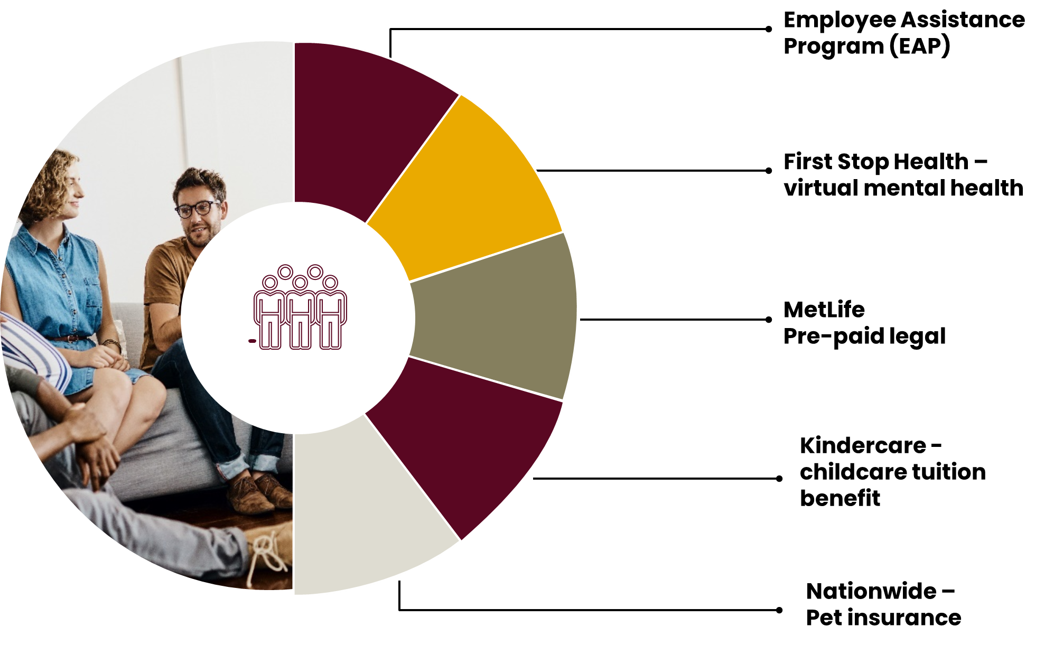
Other Benefits
LOYOLA UNIVERSITY CHICAGO
Notes:
In addition to mental health resources All One Health our EAP provider offer services related too Individual counseling on a wide range of personal and work issues;
Supervisor and manager consultations;
Work-life Resources
Workshops and seminars for departments
Health and Wellness Education.
Life Coaching
Personal Assistant
Medical Advocacy
Financial and Legal
Visit www.luc.edu/hr to find information on a variety of other benefits available to you, including:
Tuition benefits
Kindercare
Employee Assistance Program (EAP)
Credit union
EMERGE & Skillsoft training programs
WW (Weight Watchers Reimagined)
Employee discounts - www.luc.edu/hr/discounts
AAA and other travel-related services
Divvy
Equinox
Computers/software
Cell phone bills
And many more!
Empower wellness rewards programs. The Wellness Reward Program offers incentives to help you reach optimum health. Earn quarterly Wellness Rewards—bonus money in your paychecks for every quarter you complete the requirements. To receive the Quarterly reward you must be an actively employed, benefits-eligible faculty or staff member and register an account via the Empower Health Services portal. All quarterly rewards received are taxable. Actively employed faculty and staff will receive their rewards via their paycheck.
75 dollars quarterly reward.
Sign up and log your activity on the HMI Wellness Portal:
Myhmihealth.com
Site Code L773
63
‹#›

Slide 33




Enrolling in Benefits
Employee Self-Service (ESS)
Tobacco Premium
Complete your new hire benefit enrollment in ESS within 31 days of your start date.
Spousal/LDA Premium
FSA Elections
Verify Dependents and Beneficiaries
Flimp-Plan Select
Visit FLIMP:
https://flimp.live/Loyola_University_PLANselect
LOYOLA UNIVERSITY CHICAGO
Notes:
AGAIN, reminder that you have 31 days maximum from the date you are eligible to make your elections for the remainder of this year. You must go out to the self service portal and choose which plans you want or waive the plans you don’t want. Lastly, remember that when you are enrolling, you and your covered spouse/LDA must complete the tobacco and spousal/LDA certification to avoid increased premiums. This must be done by both you and your spouse/LDA if you are covering them on one of the Loyola medical plans.
If you wish to waive benefits, please log into Employee Self- Service to do so.
Enrolling in Transit:
Visit https://benefitslogin.wexhealth.com/Login.aspx?ReturnUrl=%2f
Need assistance in picking a benefits package?
Don’t forget about Flimp
Premium rates and other information can be found online
on the Human Resources website and in the Benefits Booklets at www.luc.edu/hr/benefits

Slide 34

Thank You!
Human Resources
Academic Affairs
Email: benefits@LUC.edu ​
Phone: 312.915.6175 ​
Website: www.luc.edu/hr

